Slide 1
Plate Tectonics
How do the plates move?

Slide 2
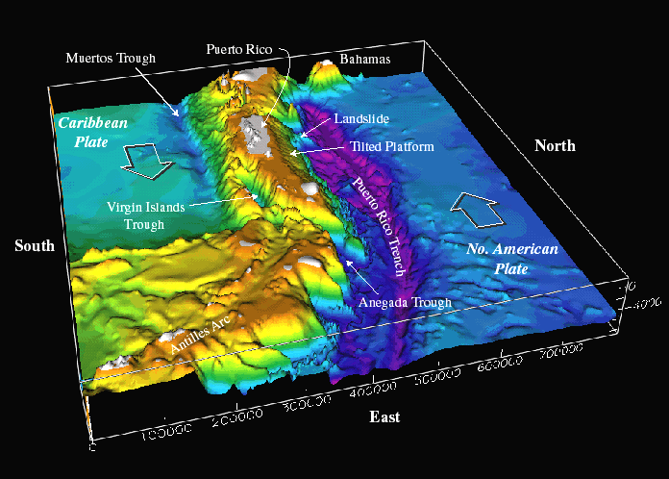
Mapping the Sea Floor
Mapping of the sea floor provided evidence to build the theory of plate tectonics.
Scientists expected the sea floor to be smooth and level, but instead found huge underwater mountain ranges called mid-ocean ridges.

Slide 3
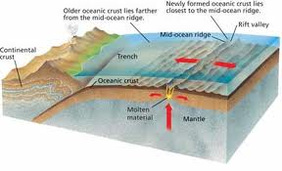
Mapping the Sea Floor
Scientists learned that the mid-ocean ridges form along cracks in the crust where molten rock rises, cools, and forms new oceanic crust.

Slide 4
Mapping the Sea Floor
The age of the sea floor provided further evidence. The oldest part of the sea floor is only 160 to 180 million years old, while the continental crust is much older (up to 4 billion years old). This confirmed that the ocean floor is constantly forming and moving away from the mid-ocean ridges like a conveyor belt.

Slide 5
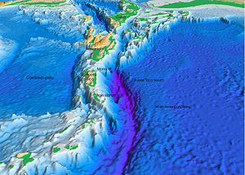
Mapping the Sea Floor
Scientists also found huge trenches where dense ocean crust is sinking into the asthenosphere.
Old crust is being destroyed at the same rate that new crust is forming, so the Earth stays the same size.

Slide 6
Types of Boundaries

Slide 7
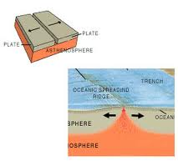
Divergent Boundary
Where two plates are moving apart
Most located along mid-ocean ridges (sea-floor spreading)
New crust forms because magma pushes up and hardens between separating plates

Slide 8
Divergent Boundary

Slide 9
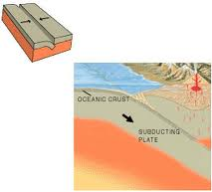
Convergent Boundary
Where two plates come together and collide
Activity depends upon the types of crust that meet;
If a more dense oceanic plate slides under a less dense continental plate or another oceanic plate, there is a subduction zone, and some crust is destroyed
If two continental plates converge, both plates buckle and push up into mountain ranges

Slide 10
Convergent Boundary

Slide 11
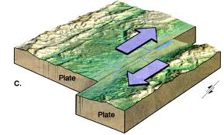
Transform Boundary
Where two plates slide past each other
Crust is neither created nor destroyed
Earthquakes occur frequently along this type of boundary

Slide 12
Transform Boundary

Slide 13
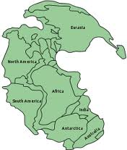
Changes in Landforms
Plates move at very slow rates – from about 1 to 10 centimeters per year
At one time the continents were joined together in one large landmass that was called Pangaea

Slide 14
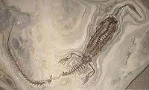
Changes in Landforms
As the plates continued to move and split apart, oceans were formed, landmasses collided and split apart until the Earth’s landmasses came to be in the positions they are now
Evidence of these collisions and splits comes from fossils, landform shape, and rock structures, and climate change

Slide 15
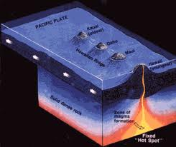
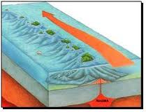
Changes in Landforms
Landmass changes can occur at hot spots within lithospheric plates (example: Hawaiian Islands)
Hot spot – where heated rock rises in plumes from the mantle
Animation

Slide 16
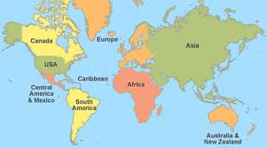
Changes in Landforms
Earth’s landmasses will continue to move and change during the geologic time of the future.

